Slide 1
Citi Bike Data Analysis
By Lauren Levin

Slide 2
Project Goal:
To better understand the behavior of Citi Bike’s customer base (both one-time users and subscribers) and how they use Citi Bikes
This will help us to:
Identify where more bikes should be installed
Create targeted marketing campaigns that will appeal to different customer segments

Slide 3
Key questions:
What are the most popular pick-up locations across the city for Citi Bike rental?
How does the average trip duration vary across different age groups?
Which age group rents the most bikes?
How does bike rental vary across the two user groups (one-time users vs long-term subscribers) on different days of the week?
Does the factor of user age impact the average bike trip duration?

Slide 4
Findings & Insights

Slide 5
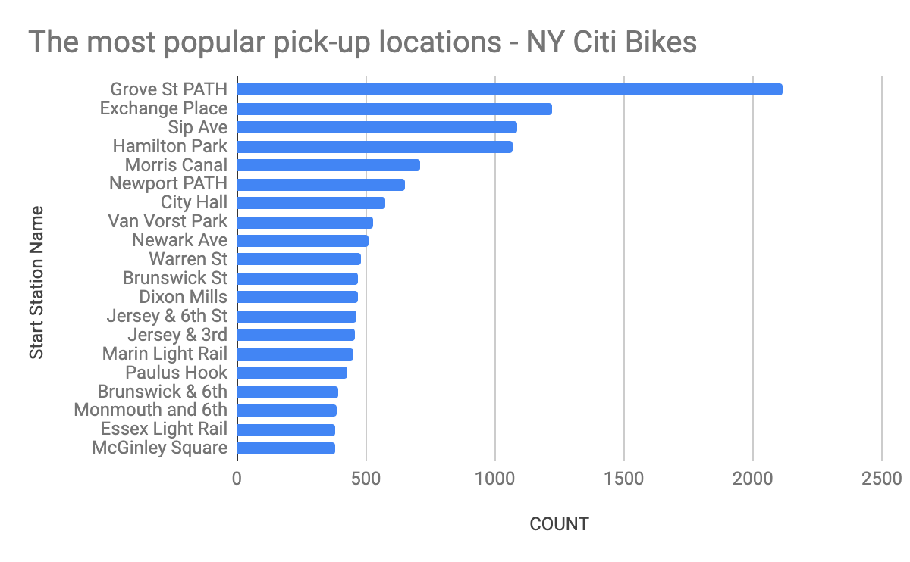
What are the most popular Citi Bike pick-up locations?

Slide 6
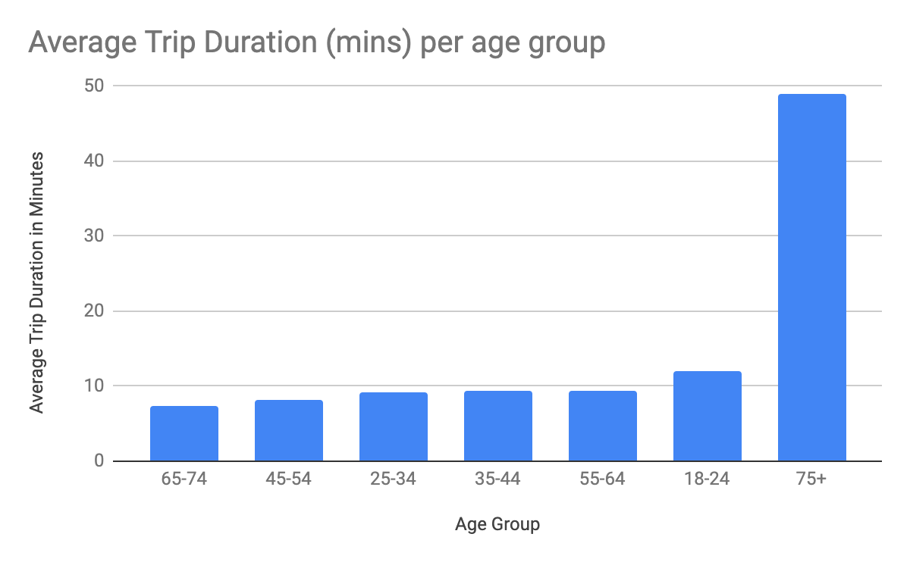
2. How does the average trip duration vary across different age groups?
On average over 75s have the longest trip duration.
Age groups 65-74 years old and 45-54 years old have the shortest trip duration.

Slide 7
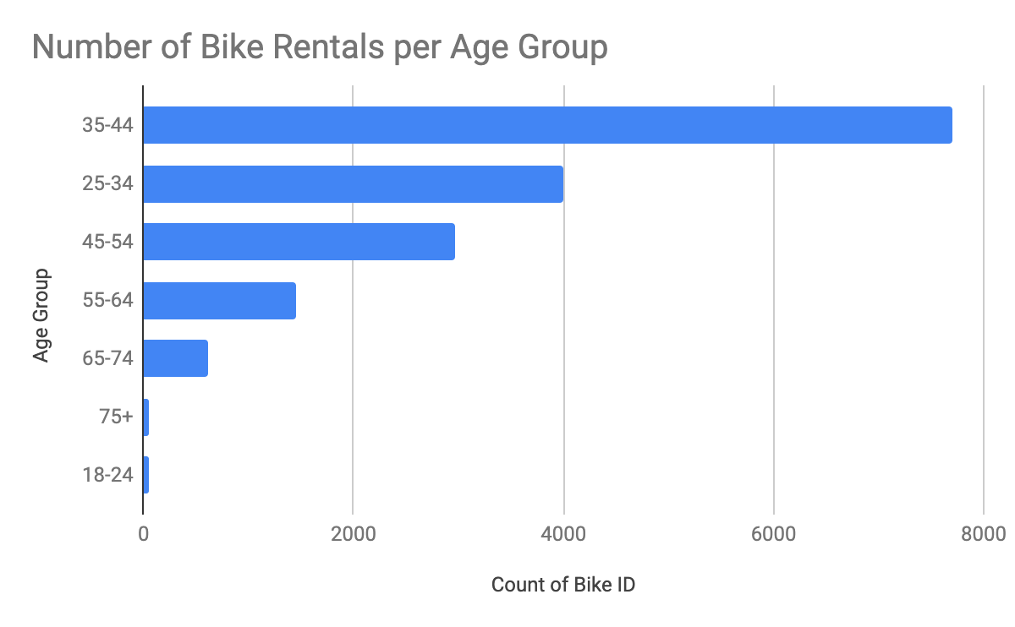
3. Which age group rents the most bikes?
The age group 35-44 year olds rent the most bikes.
Where as age groups 18-24 and Over 75 years old rent the least.

Slide 8
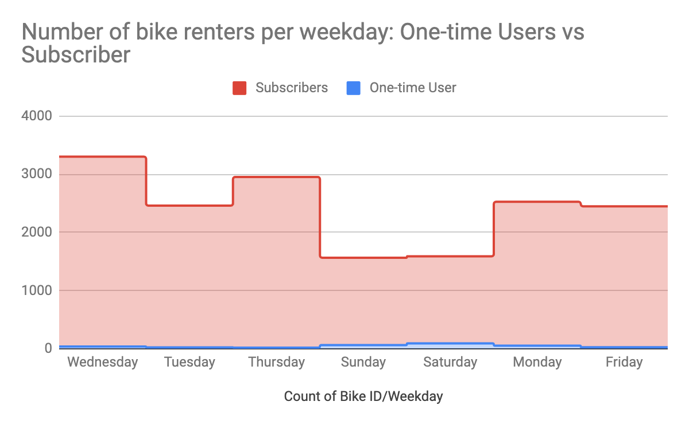
4. How does bike rental vary across the two user groups (one-time users vs long-term subscribers) on different days of the week?
One-time users predominately rent bikes at weekend.
Subscribers are most active on week-days.
Overall subscribers are the bulk of Citi Bike’s customer base.

Slide 9
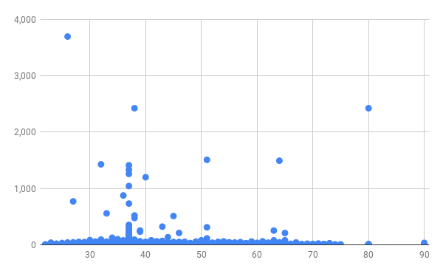
5. Do factors like weather and age impact the average bike trip duration?
There is no apparent correlation between user age and trip duration.

Slide 10
Summary

Slide 11
Summary of findings:
Top 5 pick-up locations for bikes:
Grove St Path, Exchange Place, Sip Ave, Hamilton Park, & Morris Canal
Customer base:
Citi Bike’s customer base is predominantly subscribers, whilst weekend rentals are the most popular with one-time users. Across both subscribers and one-time users the age range 35-44 rent the most followed by the age groups 25-34 and 45-54. Whilst the age groups 18-24 and over 75s are shown to rent the least. This shows us that the bulk of Citi Bike’s customer base is most likely people who live in New York using Citi Bike as a necessity for commuting..
Citi Bike customer behavior:
Citi Bike customer behavior shows on average the trip duration is 5 minutes. However, across age groups we can see over 75s have the longest trip duration out of all the other age groups. Whereas individual users who took the longest trips were in the 30-55 age range. Subscribers rent the most bikes on Wednesdays with a lower count during weekends. In comparison to one-time users predominantly renting bikes on a Saturday or Sunday.

Slide 12
Actions & Recommendations

Slide 13
Recommended actions:
Product recommendations:
Install more bikes at top 20 locations.
Marketing recommendations:
The Citi Bike customer base is mostly subscribers aged between 35-44, who are most active on weekdays. This tells us that they are probably people who live in New York and use Citi Bikes to commute. Marketing and advertising campaigns should therefore target this particular demographic.

Slide 14
Thank you!

